Slide 1
University of Basra
College of Engineering – Civil Dept.
Hydraulic Structures
By Eman Ali Abdul Karim Prof. Dr. Saleh Issa. Khassaf
2019-2020

Slide 2
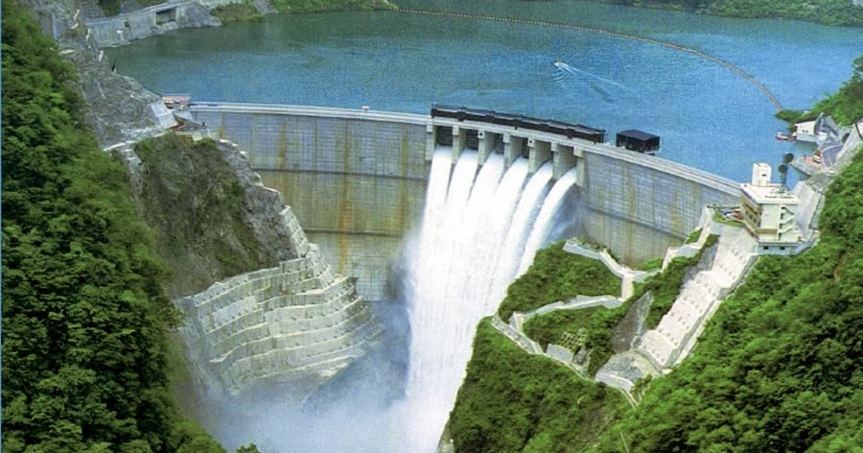
Hydraulic Structures

Slide 3
Introduction
A hydraulic structure is a structure submerged or partially submerged in any body of water.
Can be used to divert, restrict, stop, or other wise manage the natural flow of water.
Hydraulic structure are used to positively control water flow velocities, directions, depths, the elevation, slope of the stream bed and general configuration of a waterway
including its stability and maintenance characteristics .

Slide 4
Hydraulic structures can be made from materials ranging from large rock and concrete to items such as wooden timbers or tree trunks.
They can be built in rivers, sea, or any body of water where there is need for change in the natural flow water.
An example of hydraulic structure would be a dam used to hold water in reservoir as potential energy.
Just as a weir is a type of hydraulic structure which can be used to pool water for irrigation, or to control the amount of sediment and its movement in the channel, or to measure the flow of water and other advantages .

Slide 5
Many of these structures appear as special and expensive.
Proper application of hydraulic structures can reduce initial and future maintenance costs.
The shape, size and other features of hydraulic structure can vary widely for different projects, depending upon the functions to be accomplished .

Slide 6
Coffer Dam
Is a structure that is constructed inside the water for the purpose of isolating the structure to be executed, which may be in the form of cells or a polygon of various materials such as containers and water drawn through it to keep the work area dry.
It is usually used to construct or repair permanent dams, oil platforms, bridge piers and other built in or over water.

Slide 7
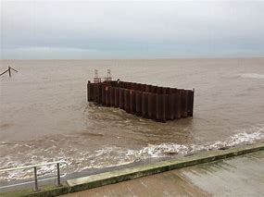
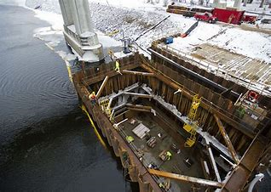

Slide 8
Failure of hydraulic structures
The foundation of any structure should be given greatest importance in analysis and design as compared with other parts of the structures, because failure in the foundation would be destroy the whole structure.
Hydraulic structure such as dam, barrage, regulators, weirs. May either be founded on an impervious solid rock foundation or an a pervious foundation, whenever such a structure is founded on a pervious foundation or sometimes the structure conveys large loads of soil as in the case of gravity dams, so that the foundation layer can be rock.

Slide 9
Cracks occur in the rock foundation during a process
construction, making it permeable to water.
When soil is permeable in this case water can leak through it , so the phenomenon of perfusion will be possible in this soil.

Slide 10
One of the things to consider :-
When storing water in any hydraulic structure, it is necessary to know the amount of water seeping from the body of the structure or from below.
The forces of water seepage from the soil that affect the stability of the foundation and the stability of structure.

Slide 11
Perfusion phenomenon results in increased seepage and increased hydraulic gradient.
The increase of seepage is caused by several reasons, including:-
High soil permeability.
Short the road followed by water when flowing in the soil.
Defects in the soil, such as the presence of cracks.

Slide 12
Failure by uplift pressure
If we consider breakdown of the hydraulic structures, we notice that it occurs when the hydrostatic pressure is below the floor of the structures or retaining walls is greater than the weight of these structures.
The hydraulic structure is always designed to resist uplift pressure, so that there must be a sufficient safety factor to a void this danger.

Slide 13
The flow network is the tool that is a available for all calculation uplift pressure and studying all aspects others are generated under hydraulic structures.
If the weight of the floor is not sufficient to resist the uplift pressure, the floor ma be broken and for this reason is that the effective length for impermeable floor will be less and in any case the final failure will occur as a result of the increase in the exit gradient.

Slide 14
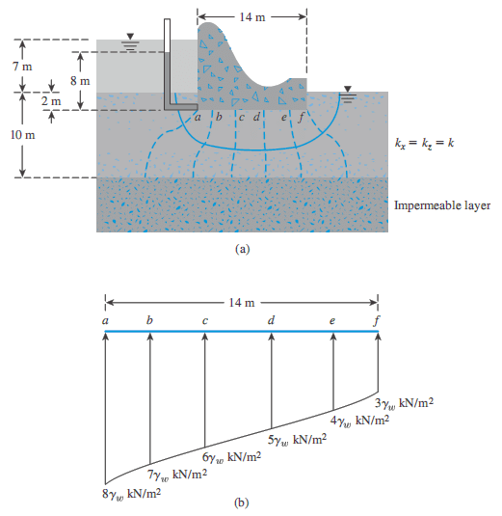

Slide 15
To prevent the failure by uplift pressure
Provide sufficiently length for the impermeable floor.
Provide suitable thickness at different points of the impermeable floor.
Place an impermeable lining at the U/S, so that the uplift pressure decreased at D/S .

Slide 16
Failure by piping
When water starts seeping under hydraulic structure, water will remain at this end of structure for a certain force.
The force may be sufficient to lift the soil particles in that area and this lead to cavitation that will continue going backwards, and thus, will cause a piping in the soil under structure, and thus, will occur breakdown in structure.
This condition occurs when the exit gradient greater than the critical gradient.
Where the soil begins to boil at the exit point of the water seeping.

Slide 17
To prevent piping
Increasing path of percolation:
The exit gradient can be reduced by increasing the path of seepage by:
Provide a sufficient length for the floor that is not permeable, so that the path of seepage increase and exit gradient decreased.
Providing U/S & D/S cutoff walls below the hydraulic structure.
Providing an impervious blanket on the upstream slop.

